Slide 1
Student Portfolio
STUDENT NAME : YUVARANI
REGISTER NO AND NMID :24132251802522057 AND
asanm225anm22524132251802522057
DEPARTMENT :B.Sc COMPUTER SCIENCE (II YEAR)
COLLEGE: COLLEGE/ UNIVERSITY:GOVERNMENT ARTS AND SCIENCE COLLEGE/ANNAMALAI UNIVERSITY

Slide 2
PROJECT TITLE
A CREATIVE STUDENT PORTFOLIO USING FWD

Slide 3


AGENDA
Problem Statement
Project Overview
End Users
Tools and Technologies
Portfolio design and Layout
Features and Functionality
Results and Screenshots
Conclusion
Github Link
3/21/2024 Annual Review

Slide 4

PROBLEM STATEMENT
IN TODAY’S COMPETITIVE ENVIRONMENT, STUDENTS NEED A PLATFORM TO SHOWCASE
THEIR SKILLS,PROJECT,AND ACHIEVEMENTS. TRADITIONAL RESUMES AND PAPER CERTICATES ARE
OFTEN INSUFFICIENT TO PRESENT A STUDENT’S FULL POTENTIAL.

Slide 5

PROJECT OVERVIEW
1.Heading:
“Projects”.
2.For each projects includes:
Project tittle-name of the project
Duration-time period
Description-3-4 lines about the projects goal and what it does .
Technologies used-list programming languages,frameworks,or tools
Role/contribution-what part you worked on front-end design.

Slide 6

WHO ARE THE END USERS?
1.RECRUITERS/EMPLOYERS
2.COLLEGE FACULTY/PROFESSORS
3.PEERS/CLASMSATES/MENTORS
4.YOURSELF(AS A CREATER)

Slide 7

TOOLS AND TECHNIQUES
TOOLS:
PROGRAMMING LANGUAGES
WEB TECHNOLOGIES
DATABASES
DESIGN TOOLS
TECHNIQUES:
PROBLEM SOLVING & DEBUGGING
RESPONSIVE WEB DESIGNS
DATA STRUCTURES &ALGORITHMS
OBJECT ORIENTED PROGRAMMING

Slide 8
PORTFOLIO DESIGN AND LAYOUT
1.HEADER AND NAVIGATION
2.INTRODUCTION SECTION
3.ABOUT SECTION
4.SKILLS SECTION
5.PROJECTS SECTION
6.CONTENT SECTION
7.FOOTER

Slide 9
FEATURES AND FUNCTIONALITY
1USER-FRIENDLY NAVIGATION
2.RESPONSIVE DESIGN
3.ABOUT SECTION
4.SKILLS SHOWCASE
5.PROJECTS DISPLAY
6.CONTACT INFORMATION
7.DOWNLOADABLE RESUME OPTION
8.VISHUAL APPEAL

Slide 10
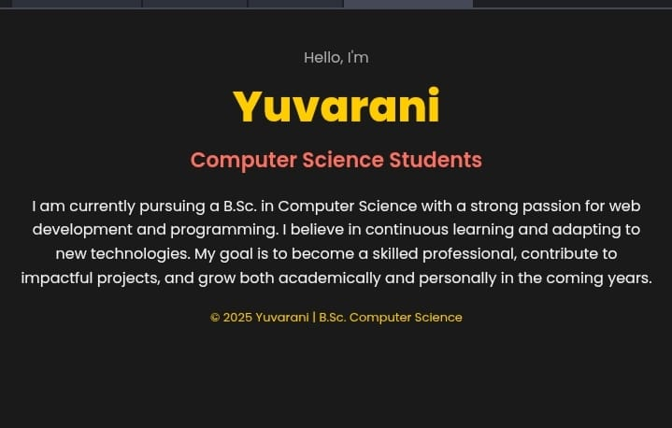

RESULTS AND SCREENSHOTS
3/21/2024 Annual Review
10

Slide 11
GITHUB
https://github.com/yuvarani789/Yuvarani-TNSDC-FWD-DP

Slide 12
CONCLUSION
A STUDENT PORTFOLIO IS AN EFFECTIVE WAY TO SHOWCASE ACADEMIC AND TECHNICAL ACHEIVEMENTS
12

